Slide 1
SECURE DATA HIDING IN IMAGES USING STEGNOGRAPHY
CAPSTONE PROJECT
Presented By: KORADA CHAITANYA
Student Name : KORADA CHAITANYA
College Name & Department : ANDHRA UNIVERSITY COLLEGE OF ENGINEERING FOR WOMEN – Department of CSSE

Slide 2
OUTLINE
Problem Statement
Technology used
Wow factor
End users
Result
Conclusion
Git-hub Link

Slide 3
Problem Statement
With rising cyber threats, ensuring secure communication is crucial. This project focuses on embedding confidential data into images using steganography, ensuring imperceptibility and resistance to attacks. Techniques like Least Significant Bit (LSB) and transform domain methods will be explored to enhance security and capacity. The goal is to achieve efficient, undetectable data hiding for secure communication and confidential data exchange.

Slide 4
Technology used
Computer Vision – OpenCV (cv2). The cv2 module comes from OpenCV, a widely used library for image processing and computer vision tasks.
Numerical Computing – NumPy. The Numpy module provides support for numerical operations, including matrix manipulation, which is essential for image processing.
Image Processing – Pillow (PIL). The PIL (Pillow) library is used for handling images, including loading, modifying, and displaying them.
Displaying Images in VSCode. To display images within VSCode, you can use the built-in image viewer or install an extension like "Image Viewer" or "VSCode Image Preview". This allows you to visualize images directly within the VSCode environment.

Slide 5
Wow factors
Unseen yet Unbreachable = Embeds data within images without discernible visual alterations, safeguarding secrecy.
Resilient Against Tampering = Employs robust methods to resist image compression, filtering, and noise.
Optimized for Data Density & Image Integrity = Strikes a balance between data embedding and preserving image quality.
Multi-Layered Security = Leverages LSB, transform domain, and adaptive steganography techniques for enhanced protection.
Instant Data Concealment & Retrieval = Efficient algorithms facilitate rapid and seamless data hiding and extraction

Slide 6
End users
Government & Intelligence Agencies = Transmit classified information securely, evading detection.
Cybersecurity Experts = Fortify data protection and covert communication methods.
Journalists & Whistleblowers = Share sensitive information anonymously, safeguarding identities.
Military & Defense = Ensure confidential communication in high-stakes operations.
Enterprises & Financial Institutions = Protect trade secrets, client data, and intellectual property.
Researchers & Academicians = Explore cutting-edge steganography techniques, driving innovation.
Individuals = Secure personal data, messages, and digital assets, preserving privacy

Slide 7
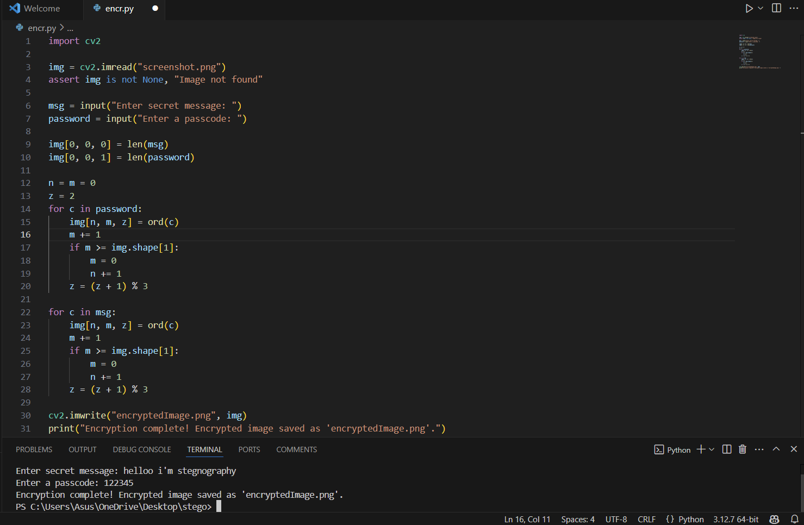
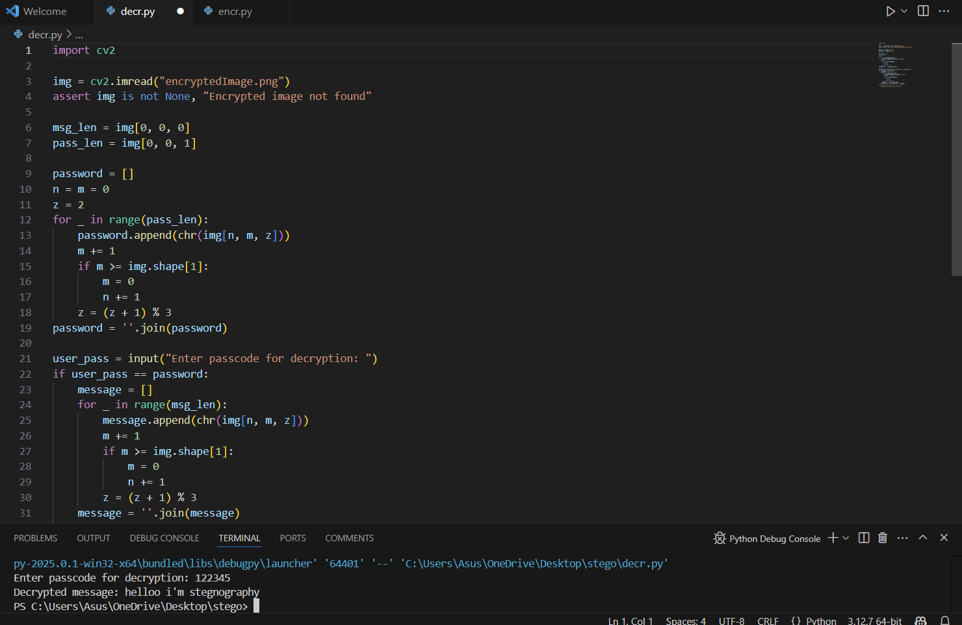


Results
Original Image file
Encrypted Image file

Slide 8
Conclusion
This project pioneers a secure, efficient, and imperceptible data hiding solution leveraging steganography. By seamlessly integrating techniques such as Least Significant Bit (LSB) substitution and transform domain methods, the system optimizes the balance between security, capacity, and imperceptibility.
The approach's robustness ensures resilience against image compression, noise, and malicious attacks, rendering it ideal for applications in cybersecurity, defense, journalism, and secure communication.
Ultimately, this project showcases a cutting-edge solution for covert data transmission, elevating digital communication security and privacy standards.

Slide 9
GitHub Link
https://github.com/koradachaitanya/stegnography.git

Slide 10
THANK YOU

